Slide 1

Web based online student union voting system for uog
Members
Full name
Ebistie Mengistie
Mulatu Mekonnen
Esubalew Marnew
Abdulhamid Mohammed
Tinsae Mathewos

Slide 2

Focus of the presentation
Introduction about the system
Requirement Analysis
System Design

Slide 3
INTRODUCTION
And Background

Slide 4
Introduction and Background
Student union is most popular in all university. It is established first in Addis Ababa University. University of Gondar is also using this union for different purposes. It solves many problems.
The election of Student union in the university of Gondar is conducted in every two years.
In our project Online voting system is a web application that allow Voters to vote their representatives easily.
Using this system election can be conducted in free and fair manner

Slide 5
Statement of the problem
Time consuming
Too much paper work
Reworking
Difficult to keep The student’s interest
Geographical limitation
Error prone manual working
Lack of security
Lack of information

Slide 6
Project Objective
General objective
Develop web based online student union voting system for UOG
Specific objective
Understand the existing system and its problem.
Gather requirement and analysis these requirement using SRS document.
Compare and contrast the proposed system with the existing system.
Design the system and its architecture using UML.
Implement and test the system.

Slide 7
Scope of the Project
It includes the area where the ongoing system is applied and what the new system is capable of doing.
The scope of this project is developing web based student union voting system for university of Gondar.
This system is cable of:
registering candidates and voters ,online vote ,count votes for each candidate, posting notice ,posting final result and send notification,
the system also allows admin to message users and generate reports.

Slide 8
Significance of the Project
This project have many significant for system users.
It save Resource and finance expenditure.
It provides equally distributed information through online for all Voters and Candidates .
Error of counting of votes will not occur because counting is done automatically by the system.
The system also enable the Administrator simply update, delete and edit information about the Voter and Candidate .
eradicates the geographical limitation and to access any where through internet connection.
Increases accuracy, availability, quality of the voting process and number of Voters as individual will find it easier and more convenient to vote.

Slide 9
Methodology
System development methods:
Object oriented approach :it used for system analysis and design .
iterative model for development of software process.
Data collection method
Observation: observing the existing system.
Document analysis: by reading documents.
Interview: face to face question with users.

Slide 10
REQUIREMENT
ANALYSIS

Slide 11
Current system function
In the current system the following activities are performed manually.
In each campus first , two students from each class of each department male and female are elected directly by getting high number of vote from their class then those students who are elected join the student union as members of parliament for the student union.
Register candidate and voter on paper
count number of vote for each candidate

Slide 12
Current system problem
Poor performance like service delay
The productivity of the voting is not effective
The voting process is prone to error
Data is not well organized and not easily accessible.
Data is not secure from damage
Manual handling of data is expensive.
Cost in terms of time is high.
The users do not get better service as their need.

Slide 13
Proposed system
The aim of proposed system is to develop improved facilities that can overcome major problems of the existing system.
Our proposed system is better than current system by the following
Reduce wide range of manual work
counts the result for each Candidate exact value electronically.
Improve accessibility of user data.
Reduce data redundancy.
Centralized information control.
Reduce the time and task required to perform the operation within the election area.
It will provide speed, efficiency, Flexibility, reliability, and security for the system users.
making easy and fast of communication held between admin, Voter, Candidates and Registrar .

Slide 14
Functional requirement
The system shall allow login to the system only for authorized and authenticated users.
The system shall allow admin to manage user account, approve account request, send notification and generate report.
The system shall allow Registrar to view notification and send student data.
The system allow SSD to post notice ,set election date, set student application date, and send notification.
The system shall allow the candidate view notice ,send account request and give feedback.
The system shall allow to voter view notice ,send account request, view candidate and vote.
The system shall allow to post final election result and allow users to view the result.

Slide 15
USE CASE MODEL

Slide 16
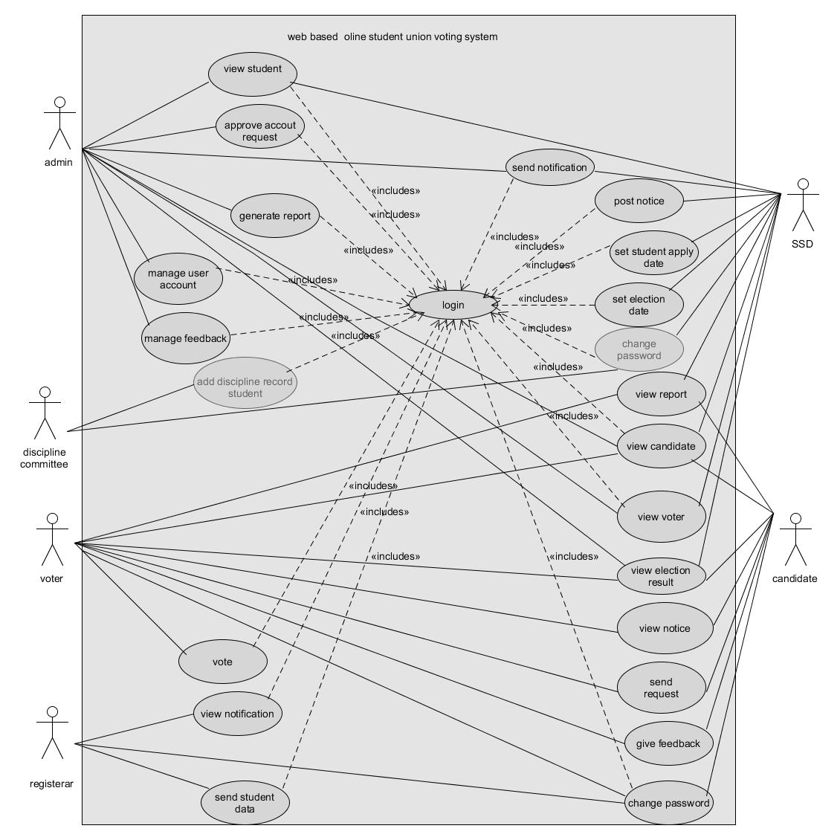
use case

Slide 17
ACTIVITY And
Sequence DIAGRAM

Slide 18
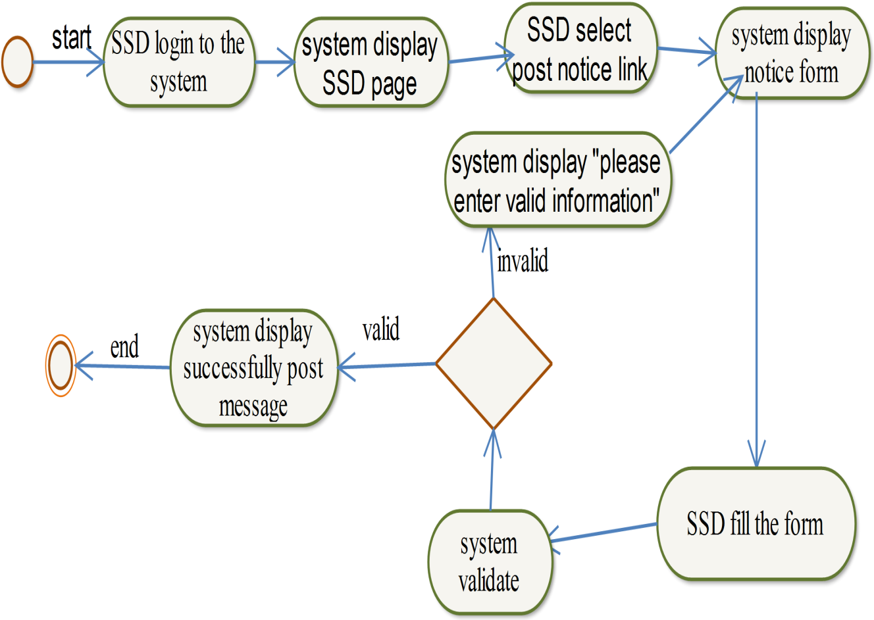
Activity Diagram for post notice

Slide 19
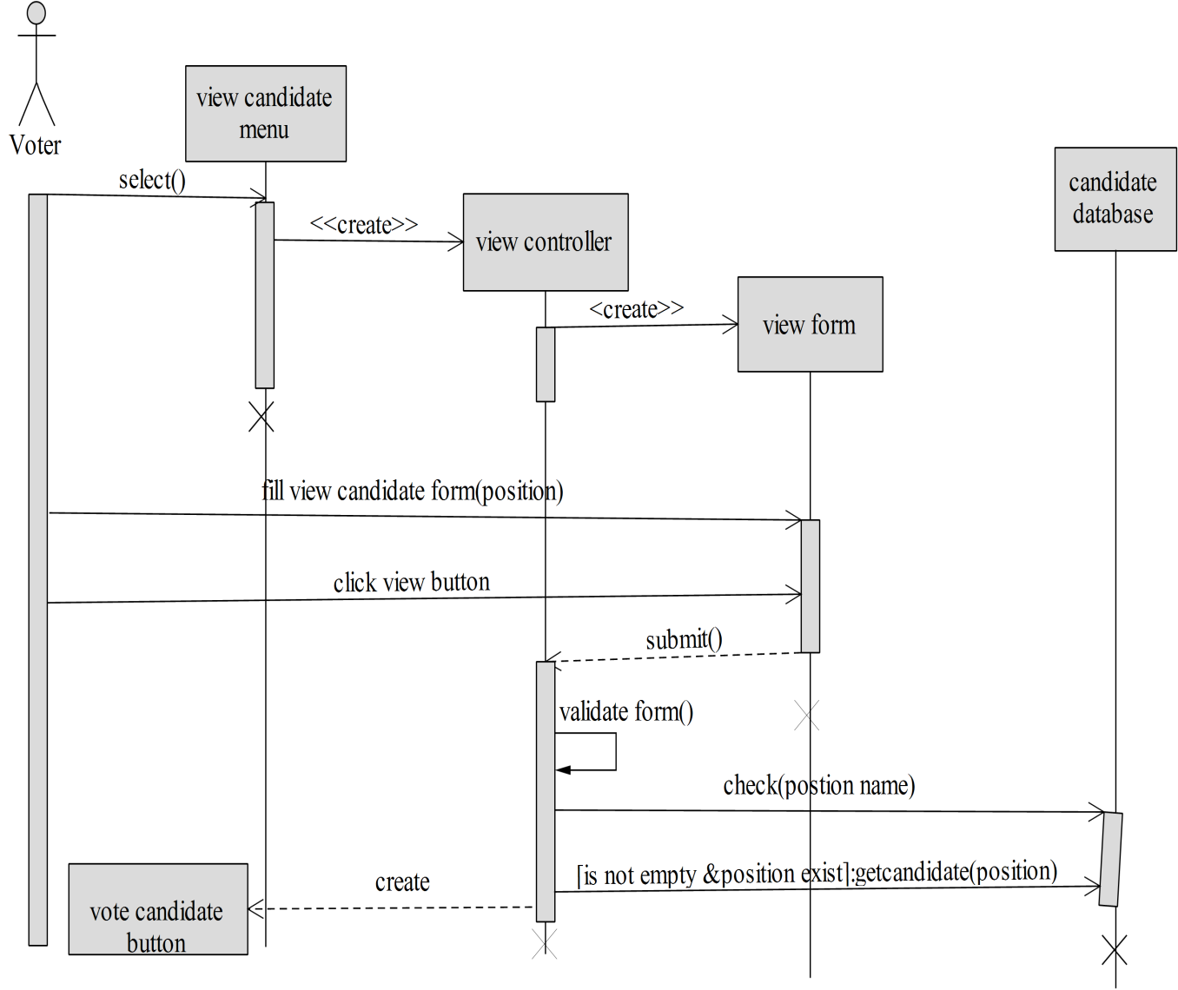
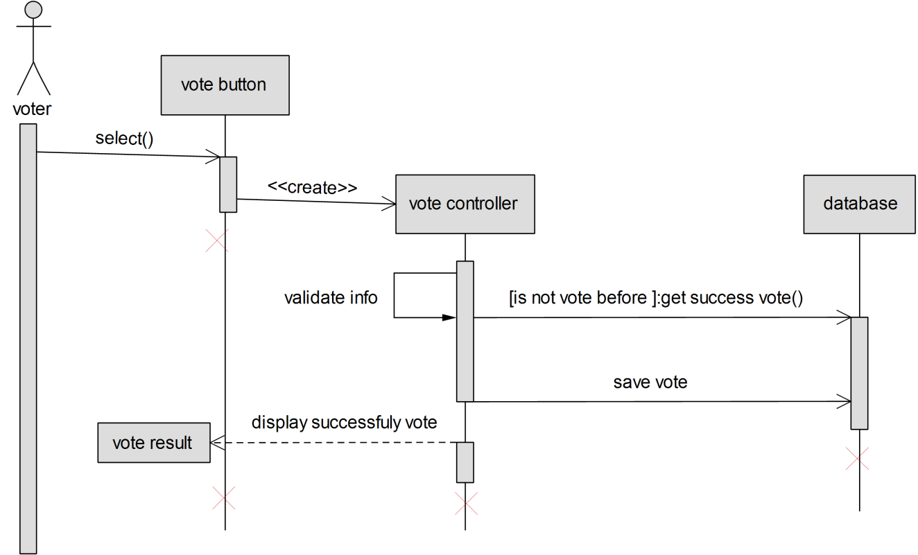
Sequence Diagram view candidate &vote

Slide 20
SYSTEM DESIGN

Slide 21
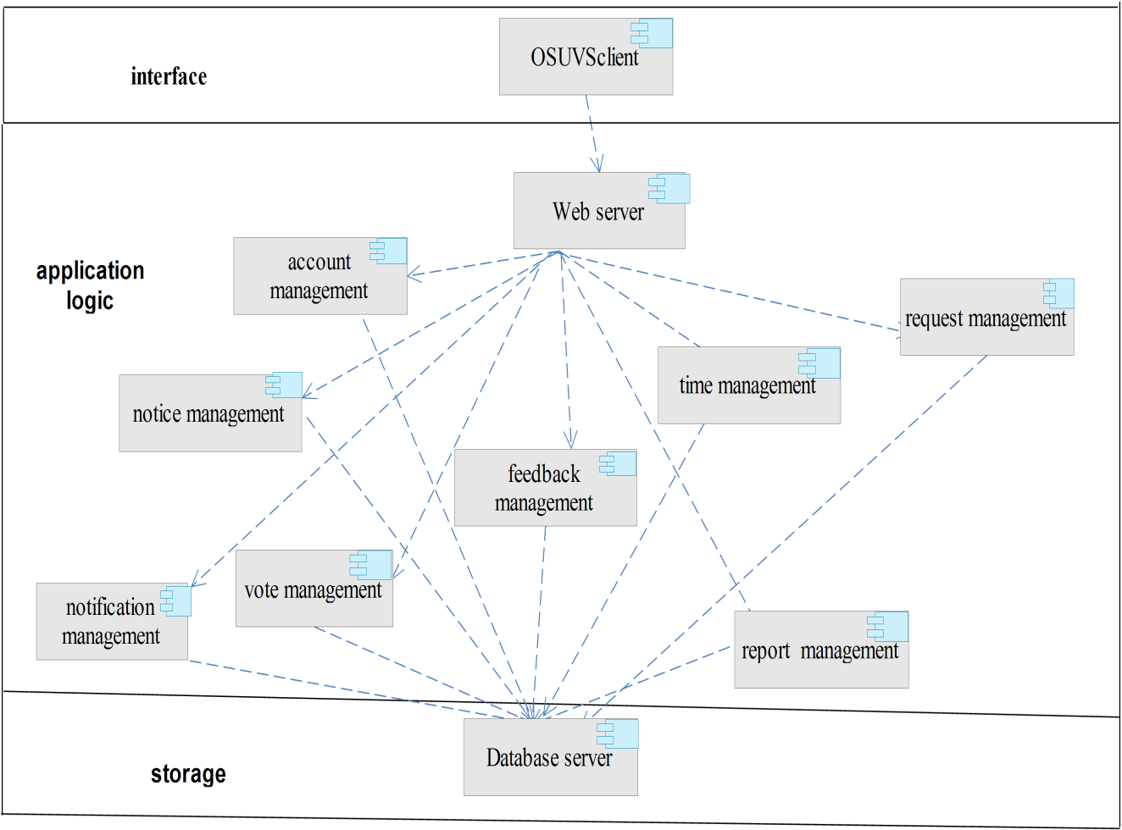
SYSTEM DECOMPOSITION

Slide 22
DETAILED CLASS
DIAGRAM
and
Persistent data
management

Slide 23
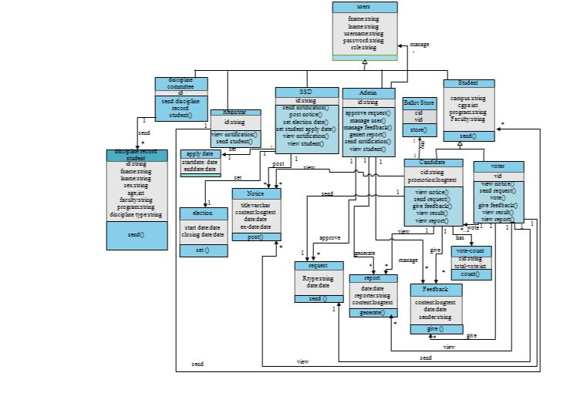
Class diagram

Slide 24
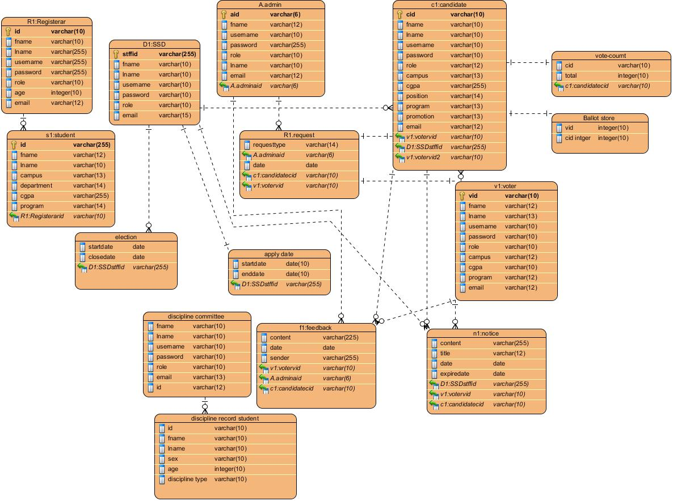
Persistent data management

